Slide 1
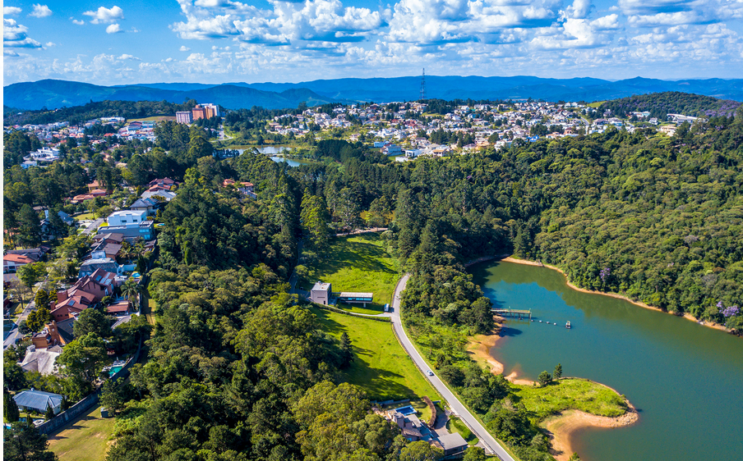
ALDEIA DA SERRA REAL ESTATE
scraping | etl | eda | ml | deploy

Slide 2
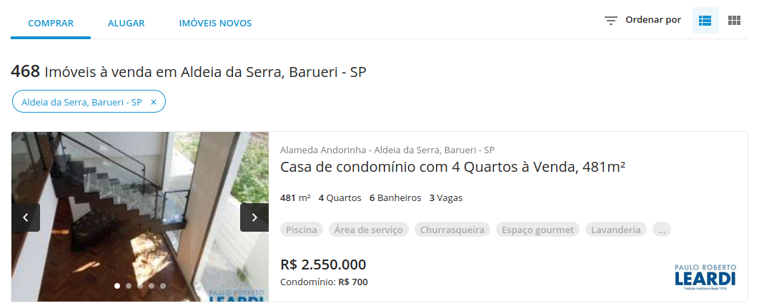
8
1
2
3
4
5
6
7

Slide 3
